Slide 1





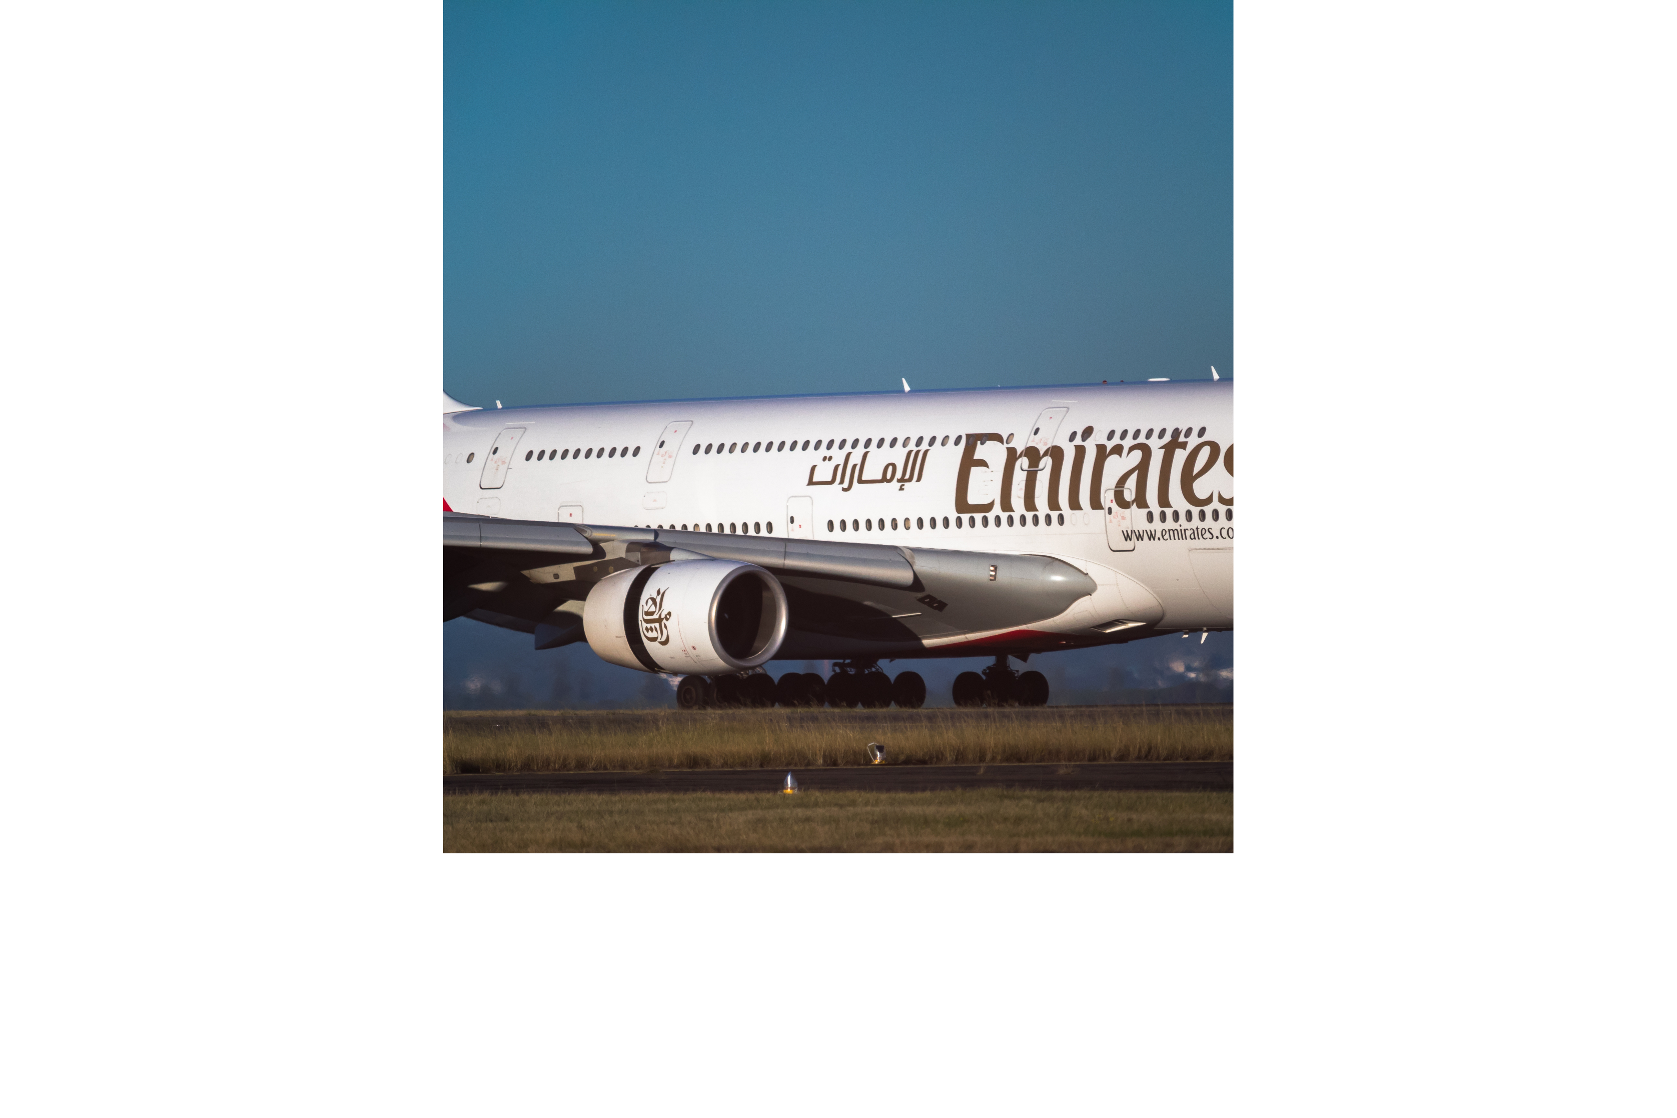

iNEURON
Data Visualization of Bird Strikes
between 2000 – 2011
WIREFRAME
DOCUMENT
PREPARED BY
SOURAV KUMAR PANIGRAHI

Slide 2
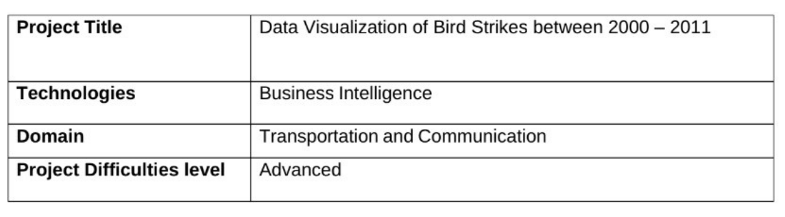
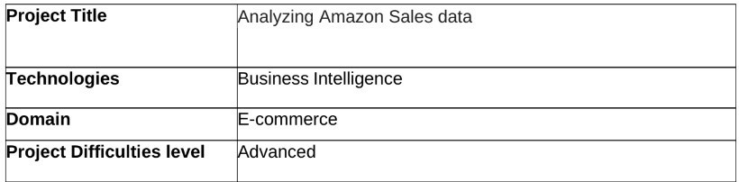
PROJECT DETAIL
OBJECTIVE
Finding number of birds strike occuring at airports based in usa and its
impace on factors such as cost, damages,
PROBLEM STATEMENT
Transport and communication is one of the crucial domain in field of analytics.
Environmental impacts and safety are, nowadays, two major concerns of the scientific
community with respect to transport scenarios and to the ever-growing urban areas.
These issues gain more importance due to the increasing amount of vehicles and people.
Seeking for new solutions is reaching a point where available technologies and artificial
intelligence, especially MAS, are being recognized as ways to cope and tackle these
kinds of problems in a distributed and more appropriate way.
A bird strike is strictly defined as a collision between a bird and an aircraft which is in
flight or on a take-off or landing roll. The term is often expanded to cover other wildlife strikes - with bats or ground animals. Bird Strike is common and can be a significant threat to aircraft safety. For smaller aircraft, significant damage may be caused to the aircraft structure and all aircraft, especially jet-engine ones, are vulnerable to the loss of thrust which can follow the ingestion of birds into engine air intakes. This has resulted in several fatal accidents. Bird strikes may occur during any phase of flight, but are most likely during the take-off, initial climb, approach and landing phases due to the greater numbers of birds in flight at lower levels. To have a closer look the following document visually depicts the data collected on Bird Strikes by FAA between 2000-2011.

Slide 3
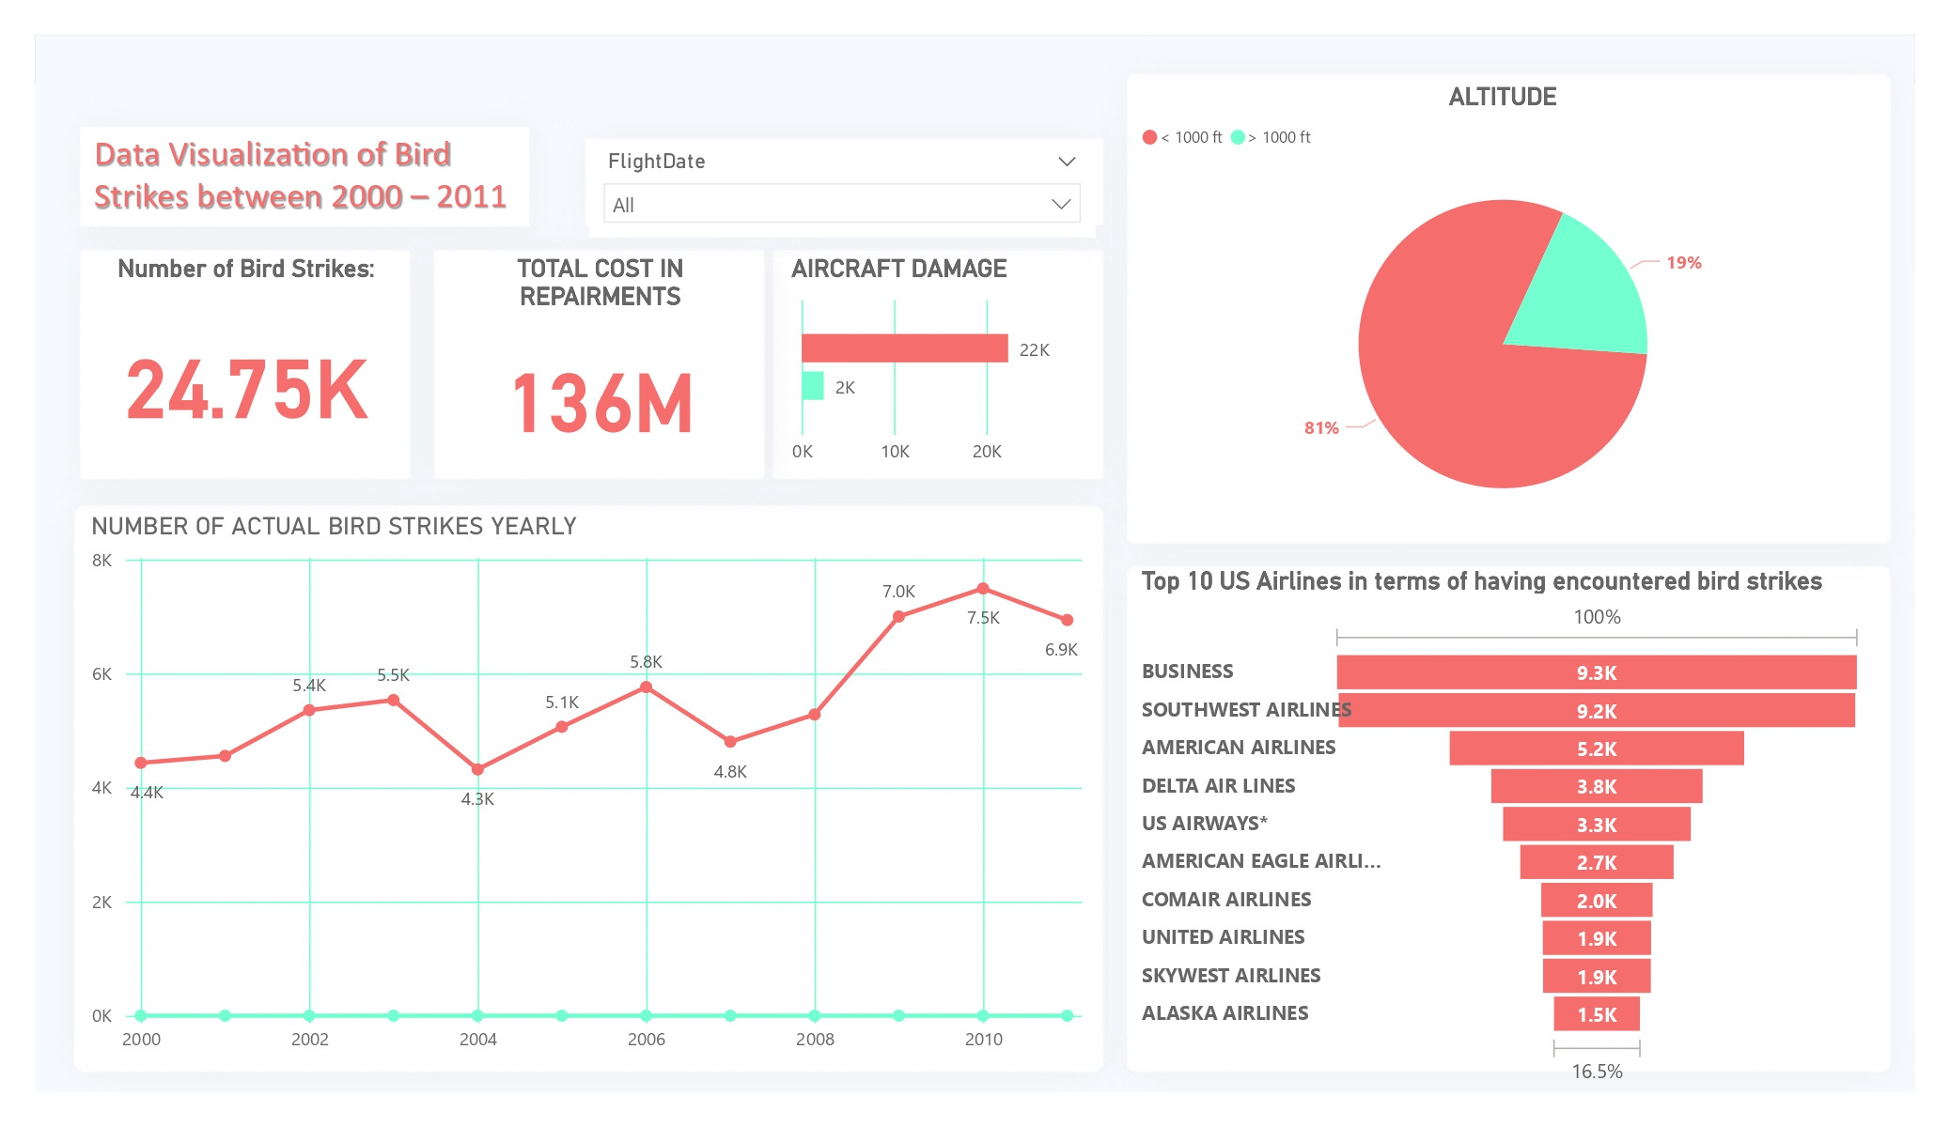
DATASET INFORMATION
This is a report related dataset that contains Information like Phase of flight,
Precipitation, Cost: Total ,Pilot warned of birds or wildlife?, Number of people injured, Feet above ground, Flight Date , Impact to flight etc.
Total number if bird strikes is around 25 thousand in the span of 11 years which
resulted in the repair cost of 136 million dollar.
Out of 24,747 flights that have been involved in a bird strike incident, 22,363
received no damage while 2384 received small to large scale damages.
Number of bird strikes continue to increase yearly from 2000 to 2011.
Airlines namely, Business , Southwest Airlines , American Airlines, Delta Air
Airlines, US Airlines are more involved in bird strikes than other airlines.
81 percent of the planes were flying at an altitude <1000 while 19 percent of
the planes were at altitude >1000 when the strikes occurred.

Slide 4
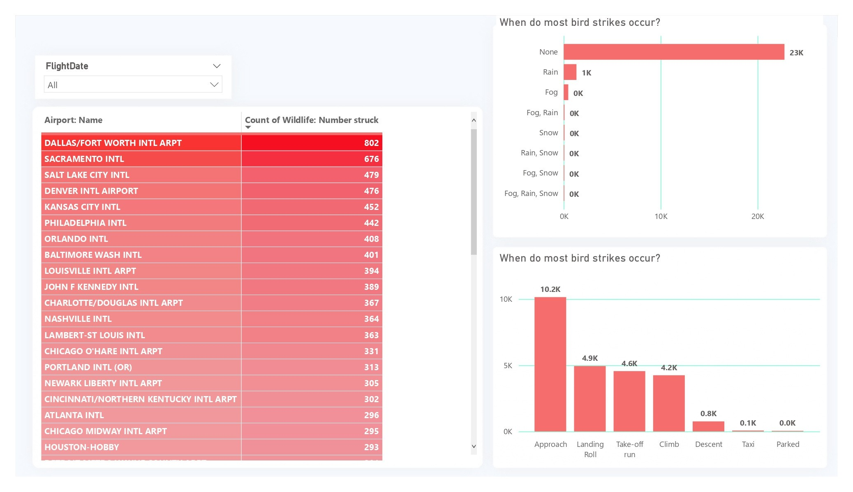
DALLAS/FORT WORTH INTL AIRPORT has the highest number of birds strikes
than any other airport .it received 802 strikes, followed by SACRAMENTO INTL
with 676 strikes .
SALT LAKE CITY (479), DENVER INTL AIRPORT (476) , KANSAS CITY INTL (452)
, PHILADELPHIA INTL (442) are among the top airports with most number of
air strikes.
Rain, Fog or Snow has little to no relation with respect to bird strikes and its
seen in most of the cases when strike occurred, the weather was fine.
A high number of strikes occurred when the plane was approaching the
runway.
Strikes also occurred when the planes were taking off, landing, climbing to
altitude or descent
almost no strikes were reported when planes were either parked or being
taxied

Slide 5
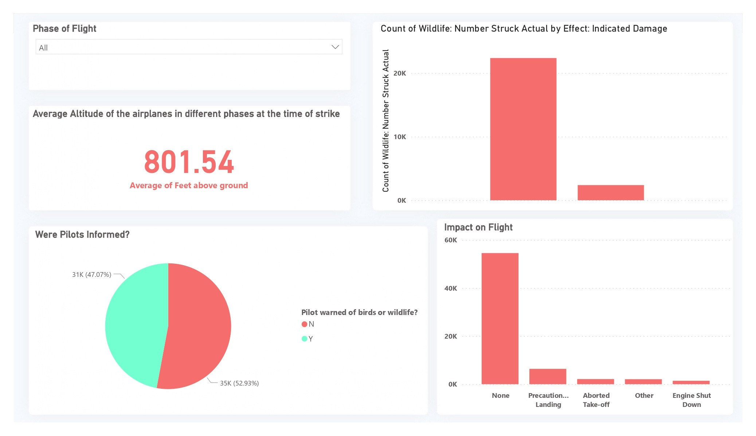
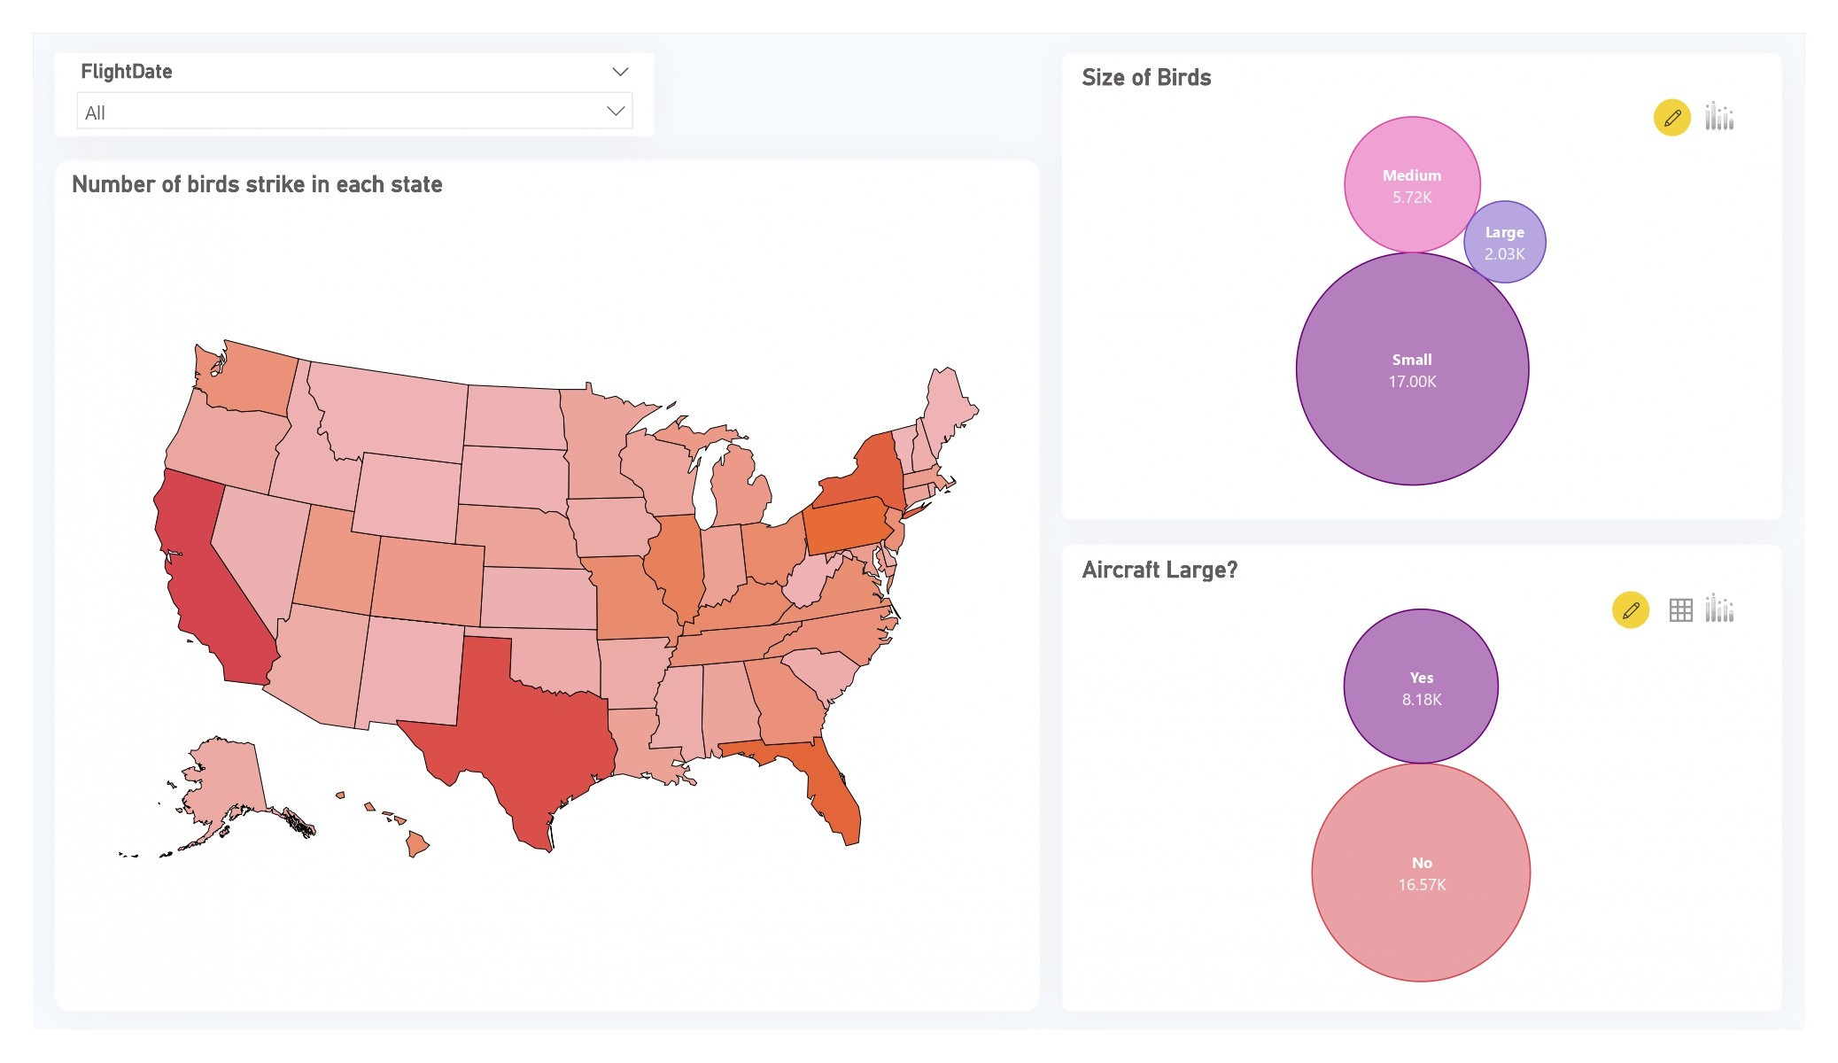
In 52 % cases pilots were not informed or were unaware of the possible bird
strikes where as in 47 percent cases they were informed prior to the strikes.
81 % bird strikes results in no damage to the plane or the flight schedule.
9.59% bird strikes resulted in precautionary landing of the flight.
3.21 % bird strikes resulted in Take-off being aborted.
2.21% bird strikes caused engine shut down.
Average altitude at which most of the strikes occurred is 800 ft. from ground.

Slide 6
The state of California is involved with most number of bird strikes in all of the
USA at 6998 strikes , followed by Taxes with 5983.
States like Montana received a comparatively low number of strikes.
In most of the cases aircraft involved was not a large aircraft
Size of birds was small in most of the cases of bird strikes follwed by medium
and then large.

Slide 7
THANK
YOU

